Slide 1
ANANYA COLLEGE OF PHYSIOTHERAPY
Op. Sindabad Hotel
Ahmedabad- Mehsana HWY
Kalol - 382721,
Dist-Gandhinagar, Gujarat, India

Slide 2
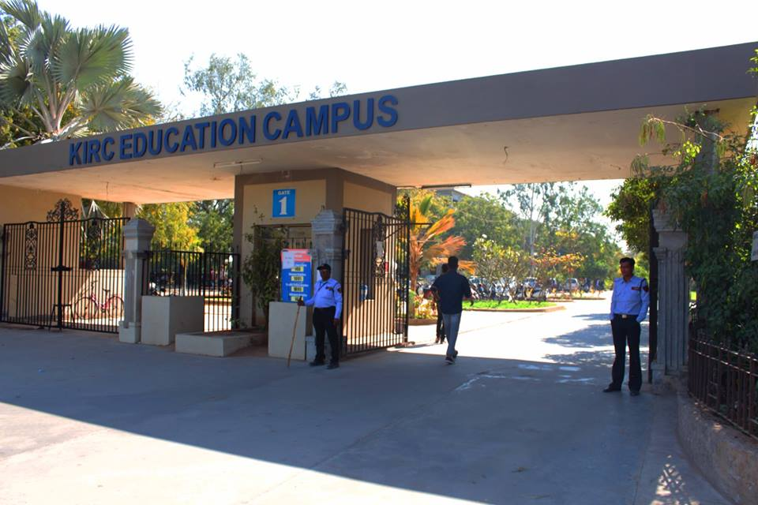

Slide 3
The Ananya College Physiotherapy in Kalol is one of the constituent of Gujarat University, established in the year 2015-2016 with the intake of 50 students.
The college is located in the disciplined and serene premises of KIRC Kalol.
It has a colossal infrastructure with well-equipped Laboratories, Educational Smart Class Rooms, Excellent Library Facilities and Huge Sports Complex for Indoor & Outdoor Games.
The physiotherapy college is well equipped Physiotherapy Clinic to provide excellent health care facility to community and also have done MOUs with well-known multispecialty hospitals in Ahmadabad and kalol

Slide 4
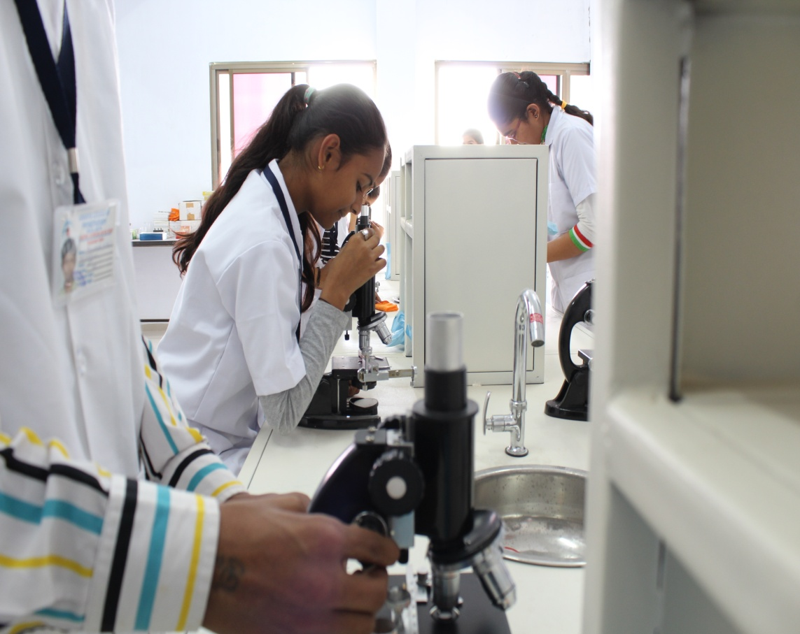

Slide 5
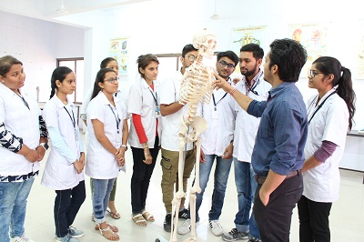

Slide 6
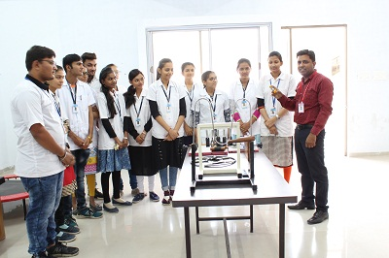

Slide 7
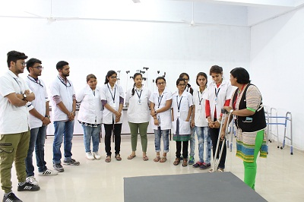

Slide 8
Courses Offered
B.P.T (Bachelor of Physiotherapy Course)

Slide 9
Admission in Bachelor of Physiotherapy (BPT)
Admission through Admission Committee for Professional Medical Educational Courses of Government of Gujarat on the Basis of Merit at B. J. Medical College, Asarwa, Ahmadabad. The details can be obtained on following web address http://www.medadmbjmc.in

Slide 10
ELIGIBILITY CRITERIA
Candidate must have passed at the external evaluation in Higher Secondary examination under 10+2 education pattern or equivalent examination with Physics, Chemistry, Biology, and English subjects.
Eligible Candidate should have completed the age of 17 years by 31st December of the year of his / her joining the Physiotherapy college Ahmedabad.

Slide 11
Facilities
The physiotherapy college is situated at Kalol, 20 km away from Ahmadabad. College is located in the discipline and serene premises of KIRC .
The green & clean and pollution free area of cantonment provides a great environment for all rounder development of the students in academic, clinical & extracurricular field.
The entire premises including classrooms, library, laboratories and auditorium is under CCTV surveillance for the discipline and safety purpose.
The college management is keen to work consistently on development & improvement of total quality education and career up gradation by expertise academic & clinical facilities.

Slide 12
Class rooms
The class rooms are well ventilated and enough spacious to accommodate 60 students.
All class rooms are well equipped audio visual aids with LCD projectors, Charts & models.

Slide 13
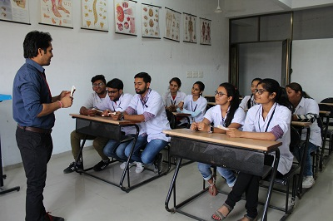

Slide 14
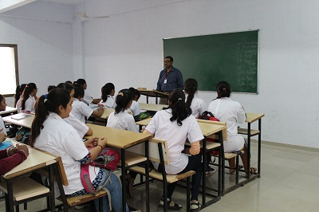

Slide 15
Library
“A blessed companion is the book, A book that fitly chosen, is a lifelong friend.”
The college library provides well balanced collection of wide range of books, E- Books, journals; important collection of relevant CD’s and high speed internet facilities with ergonomically arranged table and chairs

Slide 16
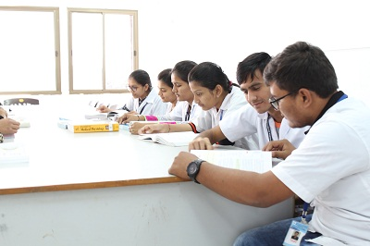

Slide 17
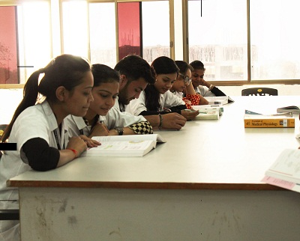

Slide 18
Auditorium
The college has auditorium facility with advance sound system and intake capacity of 300 person. Where all the annual functions, parent’s teacher meeting and non academic activities can be carried out.

Slide 19
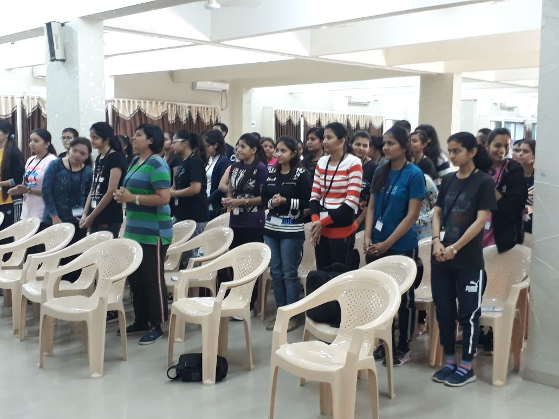

Slide 22
Laboratories
8 well equipped laboratories, including
Anatomy,
Physiology,
Exercise therapy and
electrotherapy
Cardio
Neuro(PAEDS)
Rehabilitation
Musculoskeletal
for BPT students

Slide 29
Playground
The physiotherapy college premises in which encompass all the outdoor games like Cricket, Basketball, Football, Volleyball and badminton for the all-rounder development of students.

Slide 30
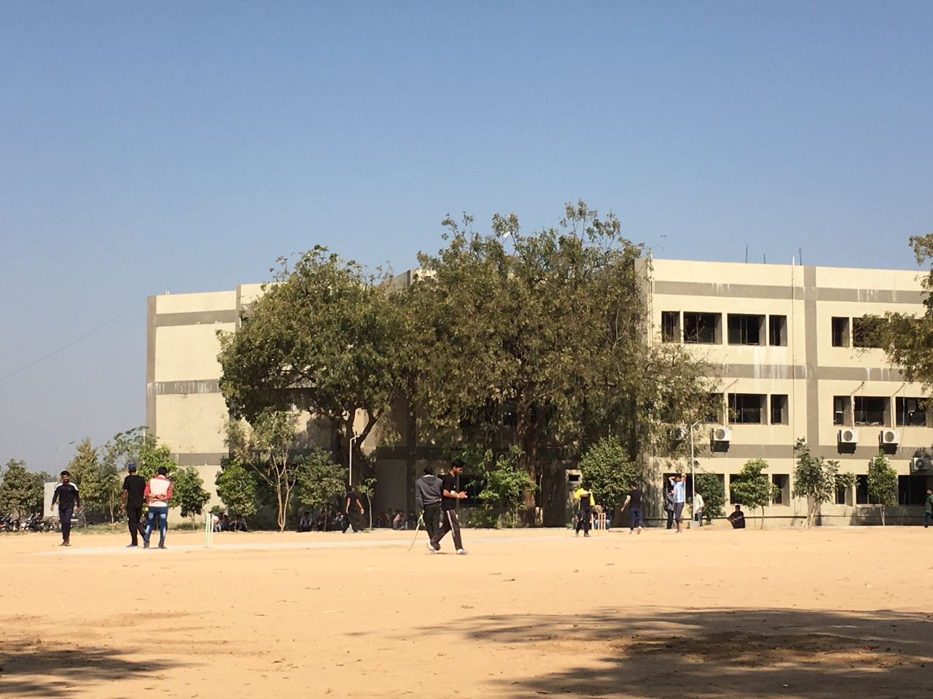

Slide 31
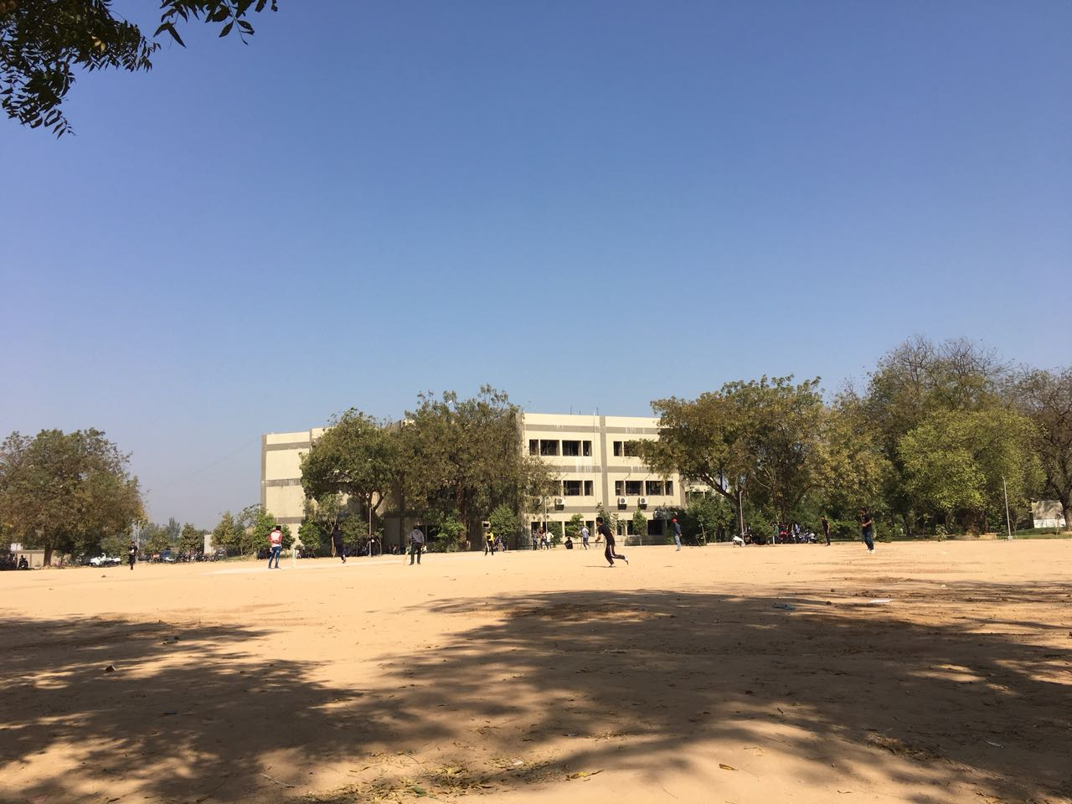

Slide 32
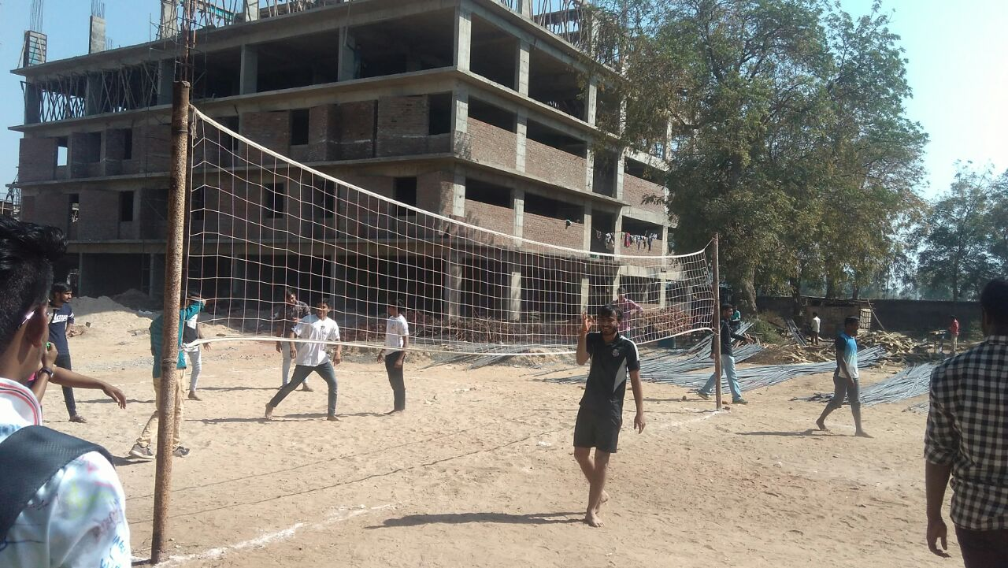

Slide 33
Physiotherapy Clinic
The physiotherapy college has its own well equipped rehabilitation clinic, where all type of patients Including traumatic & non traumatic orthopaedic cases, neurological imbalance paediatrics, cardio- respiratory cases and geriatric cases is been treated. The clinical facility of Ananya College of Physiotherapy is serving around 20-25 km of surrounding population of kalol

Slide 34
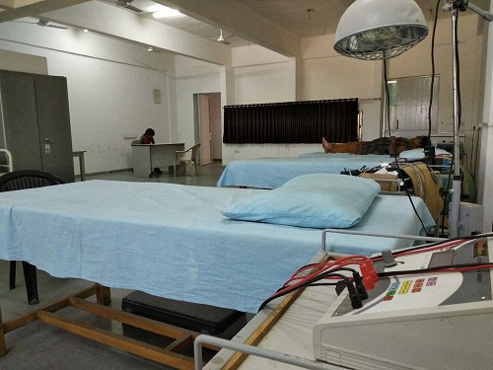
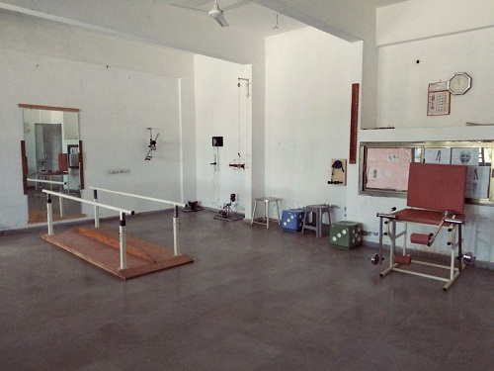
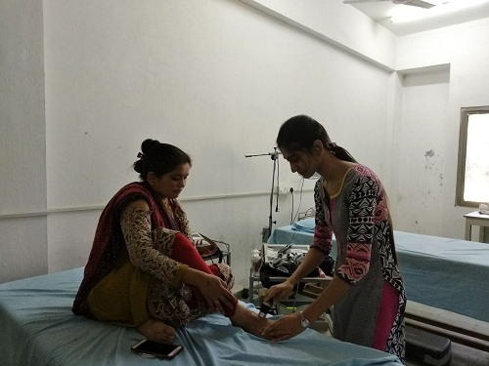
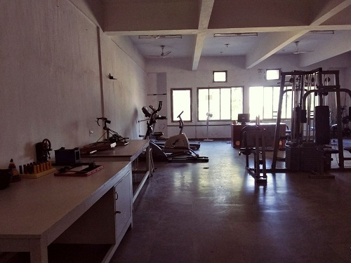

Slide 38
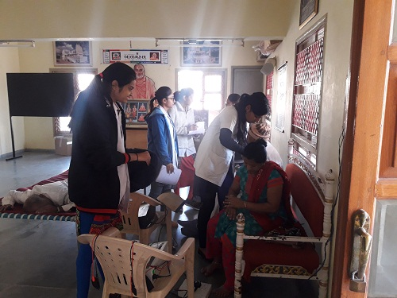
Clinical Camp

Slide 39
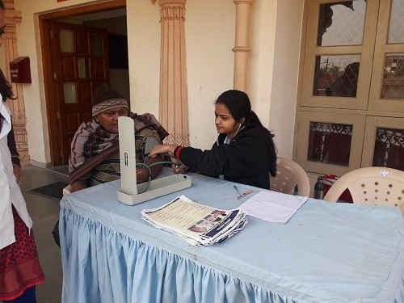

Slide 40
OUR PARENT HOSPITAL
Ananya College of Physiotherapy attached with Adarsh A Multi-Speciality Hospital has well equipped building. It is having 150 beds capacity with modern facilities and infrastructure.
Adarsh Multi-Speciality Hospital has OPD Blocks including Medicine, Surgery, Orthopaedic, Obstetrics, Gynaecology, Neonatal care unit, ENT, Minor OT, USG Room, X-RAY, Pathology Lab, ECG Room, Emergency OPD, Medical, Waiting area, and Patient wash room.
We have IPD ward of various departments & Yoga hall..

Slide 42
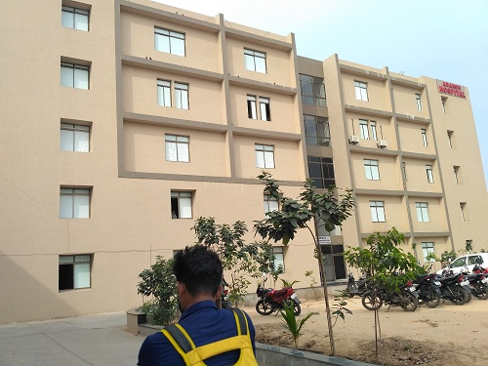

Slide 43
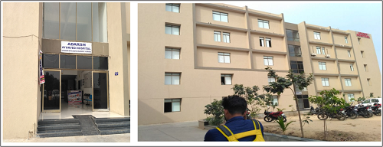

Slide 44
EVENTS

Slide 45
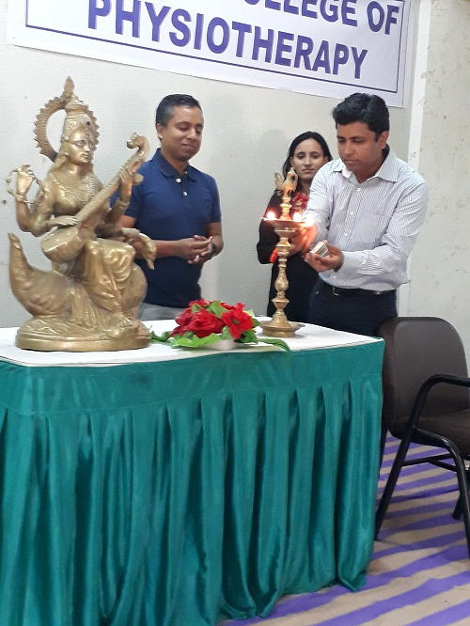
Educational Workshop

Slide 46
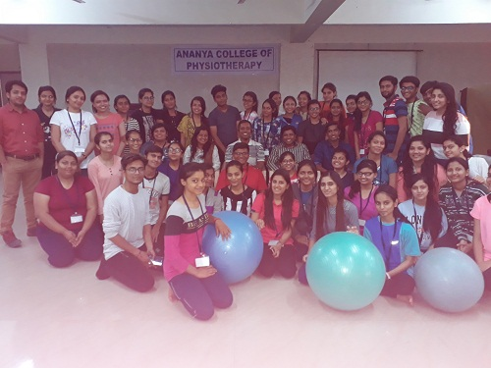

Slide 47
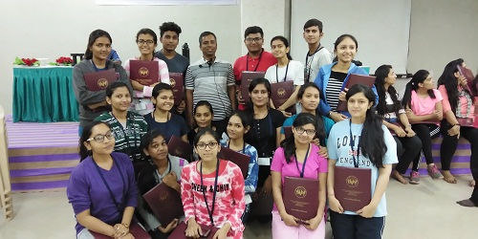

Slide 48
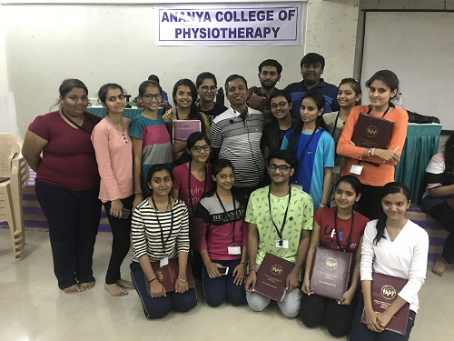

Slide 49
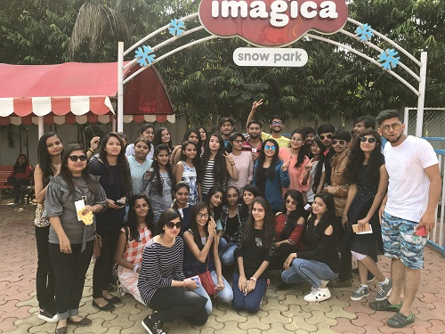
Educational Trip

Slide 51
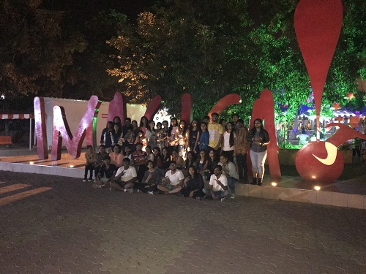

Slide 53
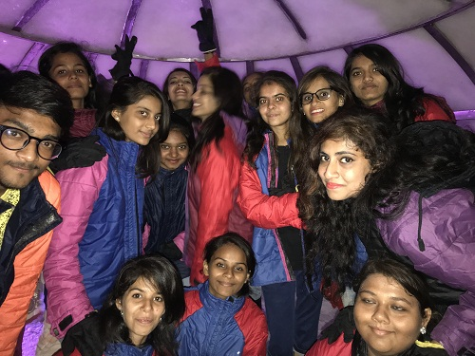

Slide 54
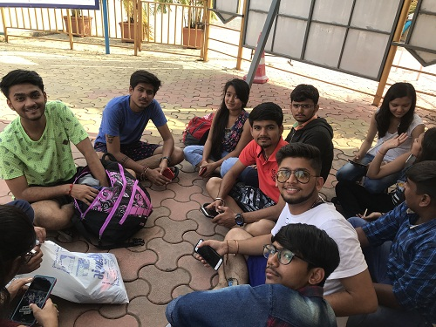

Slide 55
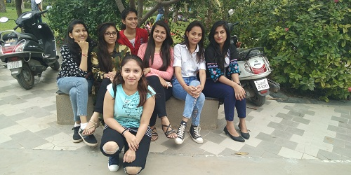
Fun Time

Slide 56
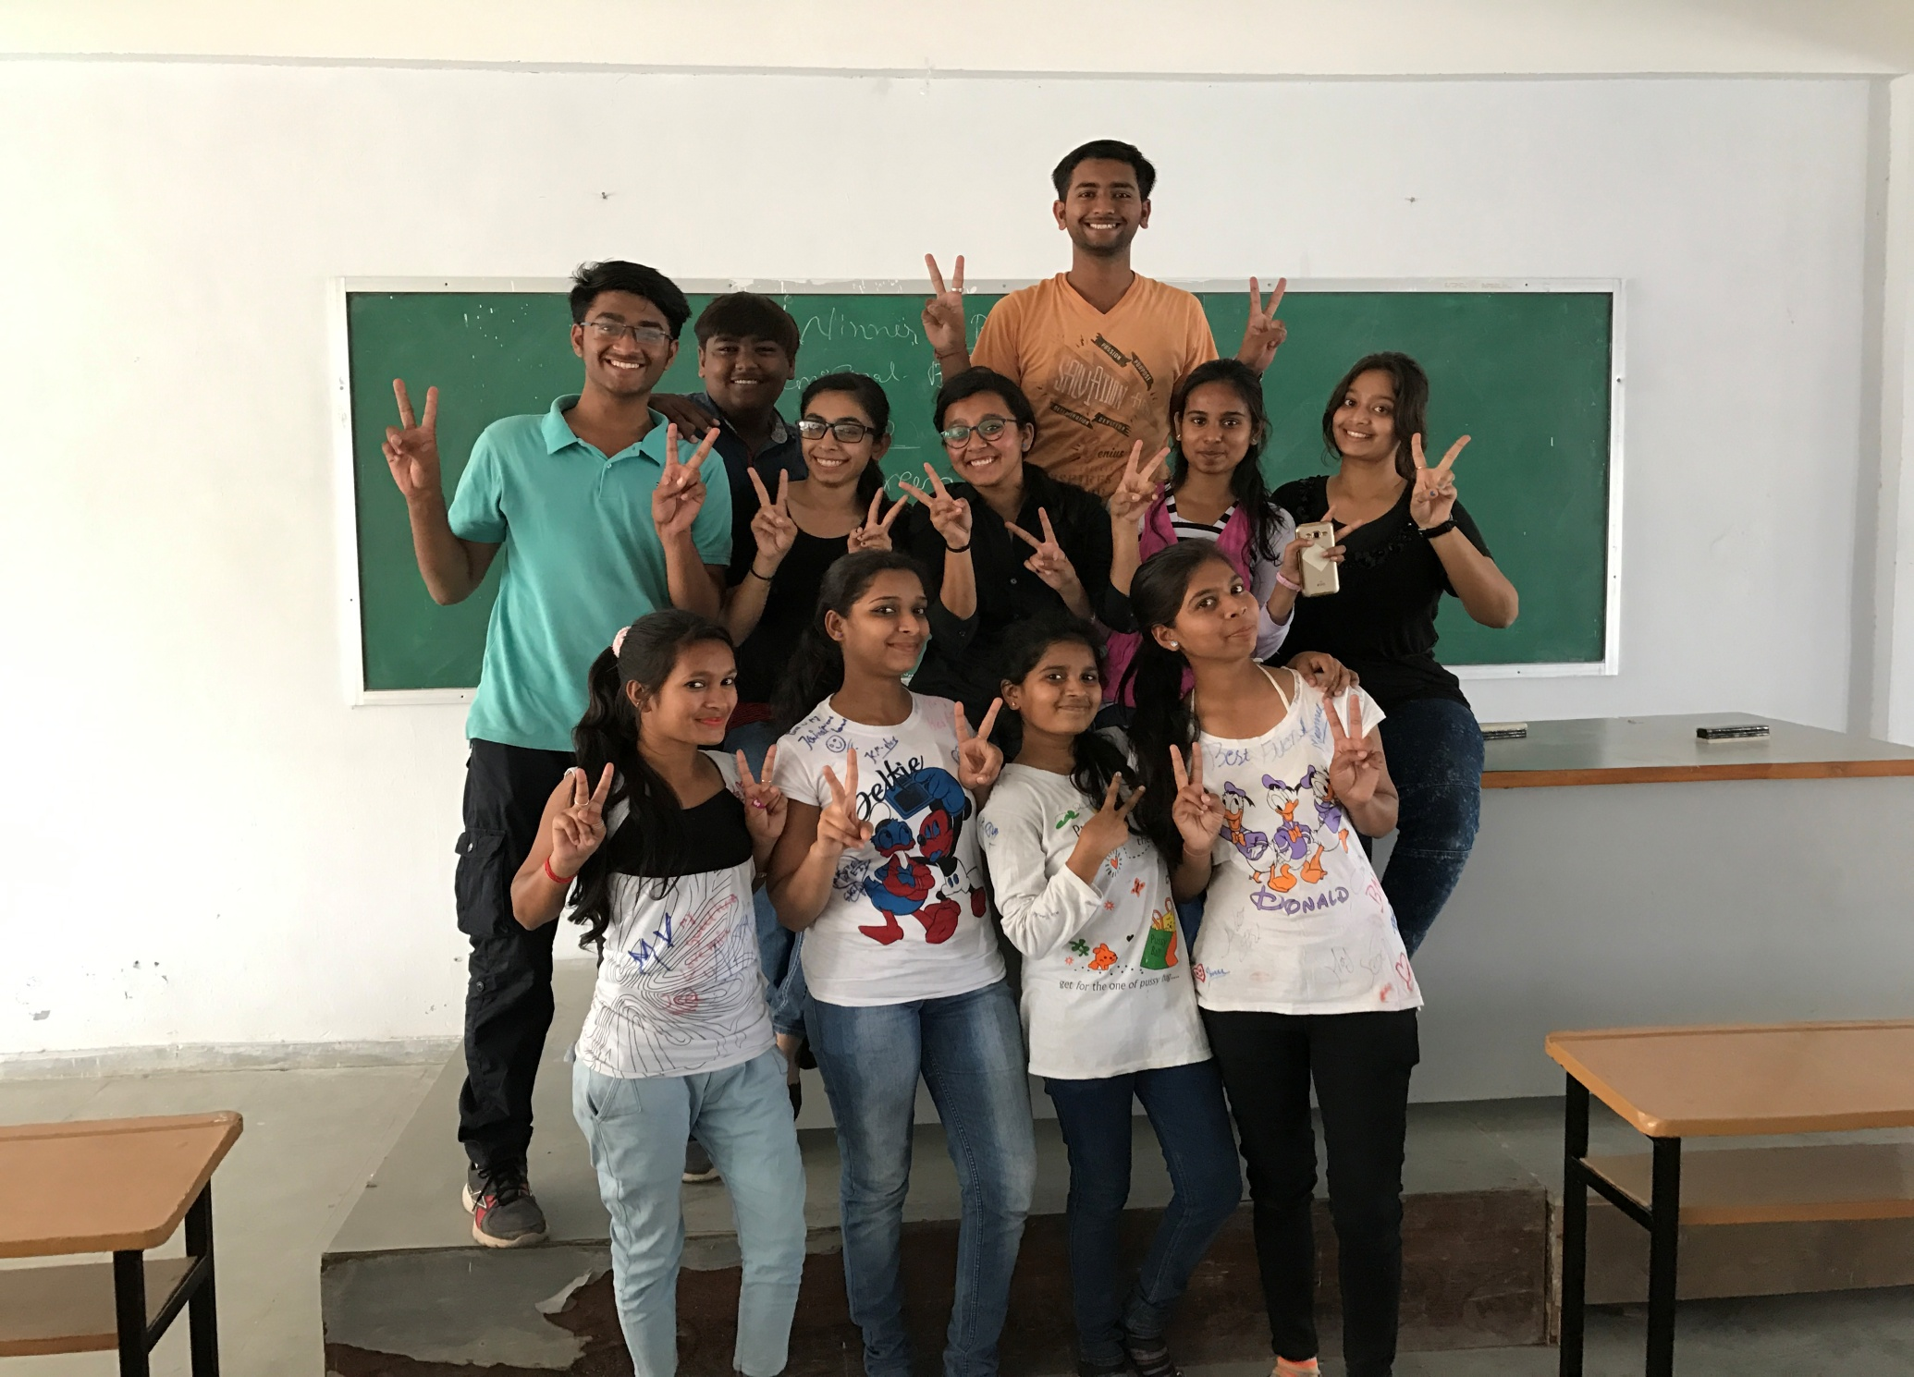

Slide 57
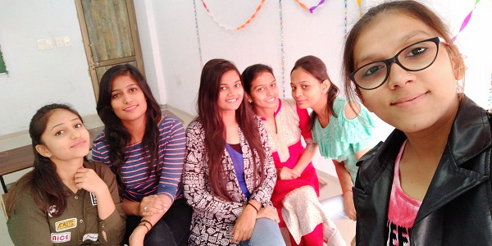

Slide 58
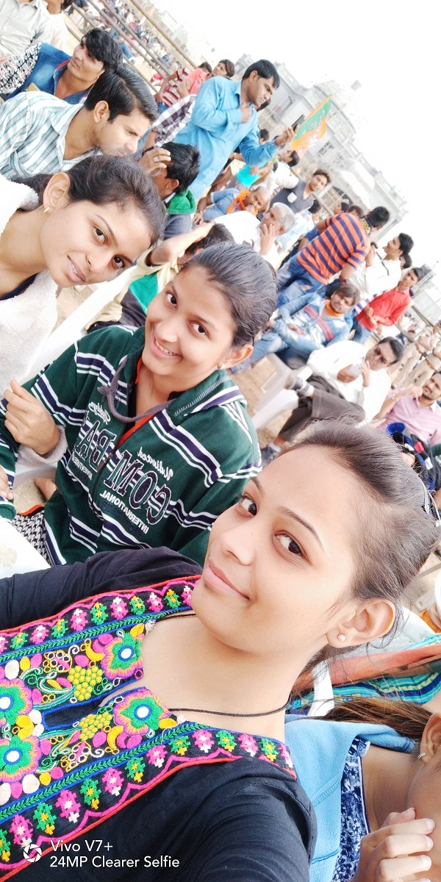

Slide 59
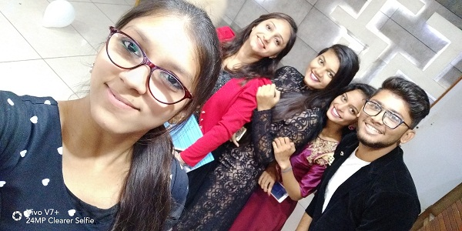
Cultural Program

Slide 60
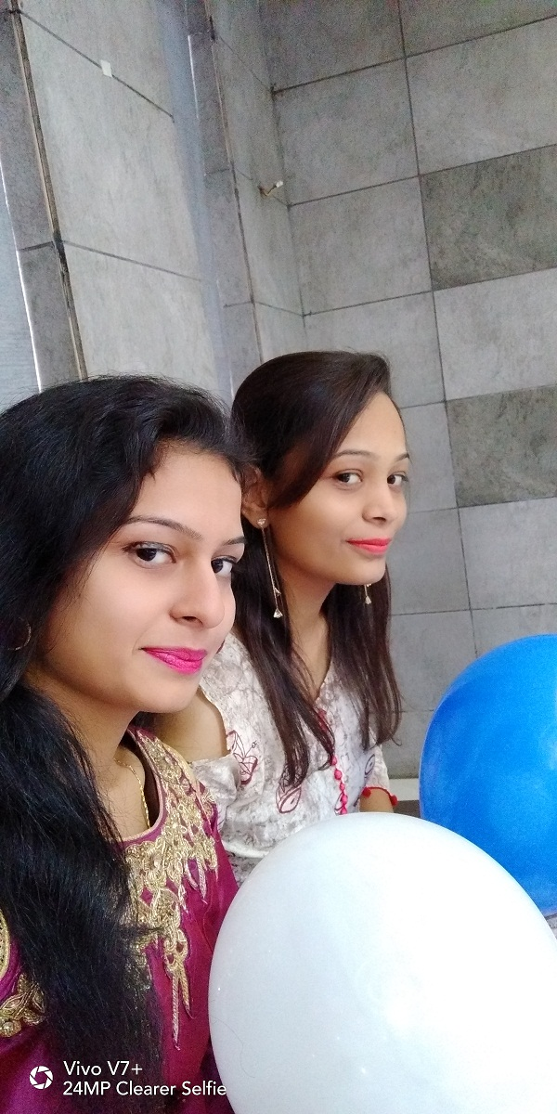

Slide 63
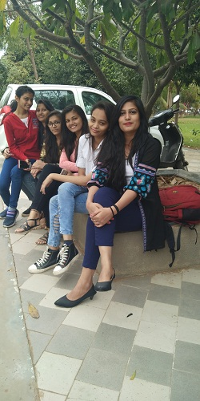

Slide 64
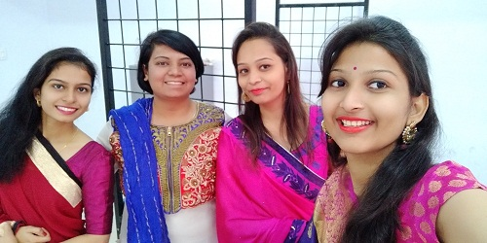

Slide 65
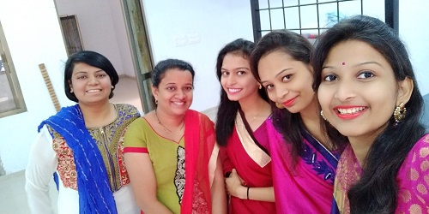

Slide 66
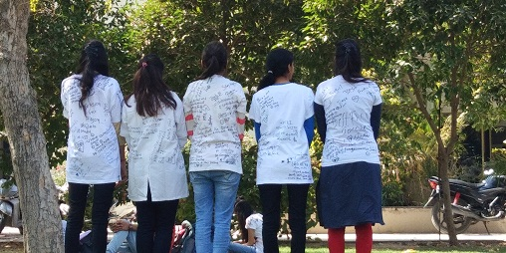

Slide 67
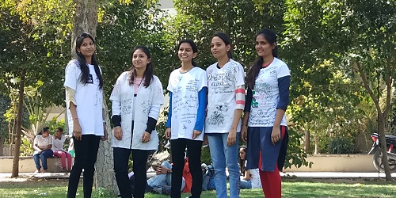

Slide 68
THANK YOU

